Slide 1
Operating Systems
Lecture 5: Disk Scheduling
William M. Mongan
Maxim Shevertalov
Jay Kothari
*This lecture was derived from material in the Operating System Concepts, 8th Edition textbook and accompanying slides. Contains Copyrighted Material
Some slides adapted from the text and are copyright: 2009 Silbershatz, Galvin and Gagne, All Rights Reserved
Lec 5
Operating Systems

Slide 2
Review: Scheduling Policy Goals/Criteria
Minimize Response Time
    Minimize elapsed time to do an operation (or job)
    Response time is what the user sees:
        Time to echo a keystroke in editor
        Time to compile a program
        Real-time Tasks: Must meet deadlines imposed by World
Maximize Throughput
    Maximize operations (or jobs) per second
    Throughput related to response time, but not identical:
        Minimizing response time will lead to more context switching than if you only maximized throughput
    Two parts to maximizing throughput
        Minimize overhead (for example, context-switching)
        Efficient use of resources (CPU, disk, memory, etc)
Fairness
    Share CPU among users in some equitable way
    Fairness is not minimizing average response time:
        Better average response time by making system less fair
Lec 5
Operating Systems

Slide 3
Recap: Scheduling (1)
Scheduling: selecting a waiting process from the ready queue and allocating the CPU to it
FCFS Scheduling
Round-Robin Scheduling
Shortest Job First (SJF)/Shortest Remaining Time First (SRTF)
Multi-Level Feedback Scheduling
Lottery Scheduling
Lec 5
Operating Systems

Slide 4
Disk Performance
Response Time = Queue time + Service Time
Service Time = Controller + Seek + Rotation + Transfer
Latency factors
  Software paths, Hardware controller, Disk media
Queueing
  Latency goes up as disk utilization approaches 100%
Achieve highest bandwidth when transferring a large group of blocks sequentially from one track
Lec 5
Operating Systems

Slide 5
Chapter 12: Mass-Storage Systems
Overview of Mass Storage Structure
Disk Structure
Disk Attachment
Disk Scheduling
Disk Management
Swap-Space Management
RAID Structure
Disk Attachment
Stable-Storage Implementation
Tertiary Storage Devices
Operating System Support
Performance Issues
Lec 5
Operating Systems

Slide 6
Objectives
Describe the physical structure of secondary and tertiary storage devices and the resulting effects on the uses of the devices
Explain the performance characteristics of mass-storage devices
Discuss operating-system services provided for mass storage, including RAID and HSM
Lec 5
Operating Systems

Slide 7
Thread Queues
When thread is not running, its TCB is in a scheduler queue
  Separate queues for each device/signal/condition
  Each queue can have different scheduling policy
Ready
Head
TCB
TCB
TCB
Tail
Disc
NULL
Head
Tail
NULL
Ether
Head
TCB
Tail
Lec 5
Operating Systems

Slide 8

Filesystem
What do we want?
Lec 5
Operating Systems

Slide 9
Filesystem
OS Layer that presents blocks of data stored on a drive as files, directories
File systems:
  Manage translation from User view to System view
  Provide security, durability, reliability
  Naming interface
System view (sys call)
  Collection of bytes/sectors
  No idea how the data is stored on disk
System view (Kernel)
  Collection of blocks
  Block size is greater than sector size: UNIX => 4KB block
  Files are collections of blocks
Lec 5
Operating Systems

Slide 10
Access Patterns
Need to optimize for most common accesses
Lec 5
Operating Systems

Slide 11
Access Patterns
Need to optimize for most common accesses
Sequential Access: (majority)
  read in order
Random Access: (an important minority)
  read from middle of file
Content-based Access:
  Search based access
  Important for database applications
Lec 5
Operating Systems

Slide 12
Usage Patterns
Need to optimize for common file types
Lec 5
Operating Systems

Slide 13
Usage Patterns
Need to optimize for common file types
Small files: (majority)
Large files: (minority)
  Use up most of the disk space
Is this still true?
Is it changing?
Lec 5
Operating Systems

Slide 14
Overview of Mass Storage Structure
Magnetic disks provide bulk of secondary storage of modern computers
  Drives rotate at 60 to 200 times per second
  Transfer rate is rate at which data flow between drive and computer
  Positioning time (random-access time) is time to move disk arm to desired cylinder (seek time) and time for desired sector to rotate under the disk head (rotational latency)
  Head crash results from disk head making contact with the disk surface
    That’s bad
Disks can be removable
Drive attached to computer via I/O bus
  Busses vary, including EIDE, ATA, SATA, USB, Fibre Channel, SCSI
  Host controller in computer uses bus to talk to disk controller built into drive or storage array
Lec 5
Operating Systems

Slide 15

Moving-head Disk Mechanism
Lec 5
Operating Systems

Slide 16
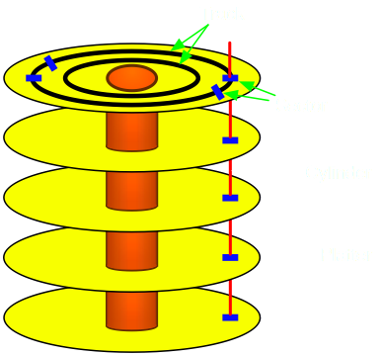
Hard Drives
Sector: Smallest element
  OS transfers groups of sectors called blocks
Can access any block directly (Random Access)
Can access files randomly or sequentially
More sectors on outer tracks
Speed varies with track location
What is our goal?
What are the problems?
Lec 5
Operating Systems

Slide 17
Overview of Mass Storage Structure (Cont)
Magnetic tape
  Was early secondary-storage medium
  Relatively permanent and holds large quantities of data
  Access time slow
  Random access ~1000 times slower than disk
  Mainly used for backup, storage of infrequently-used data, transfer medium between systems
  Kept in spool and wound or rewound past read-write head
  Once data under head, transfer rates comparable to disk
  20-200GB typical storage
  Common technologies are 4mm, 8mm, 19mm, LTO-2 and SDLT
Lec 5
Operating Systems

Slide 18
Disk Structure
Disk drives are addressed as large 1-dimensional arrays of logical blocks, where the logical block is the smallest unit of transfer
The 1-dimensional array of logical blocks is mapped into the sectors of the disk sequentially
  Sector 0 is the first sector of the first track on the outermost cylinder
  Mapping proceeds in order through that track, then the rest of the tracks in that cylinder, and then through the rest of the cylinders from outermost to innermost
Lec 5
Operating Systems

Slide 19
Disk Attachment
Host-attached storage accessed through I/O ports talking to I/O busses
SCSI itself is a bus, up to 16 devices on one cable, SCSI initiator requests operation and SCSI targets perform tasks
  Each target can have up to 8 logical units (disks attached to device controller
FC is high-speed serial architecture
  Can be switched fabric with 24-bit address space – the basis of storage area networks (SANs) in which many hosts attach to many storage units
  Can be arbitrated loop (FC-AL) of 126 devices
Lec 5
Operating Systems

Slide 20

Network-Attached Storage
Network-attached storage (NAS) is storage made available over a network rather than over a local connection (such as a bus)
NFS and CIFS are common protocols
Implemented via remote procedure calls (RPCs) between host and storage
New iSCSI protocol uses IP network to carry the SCSI protocol
Lec 5
Operating Systems

Slide 21
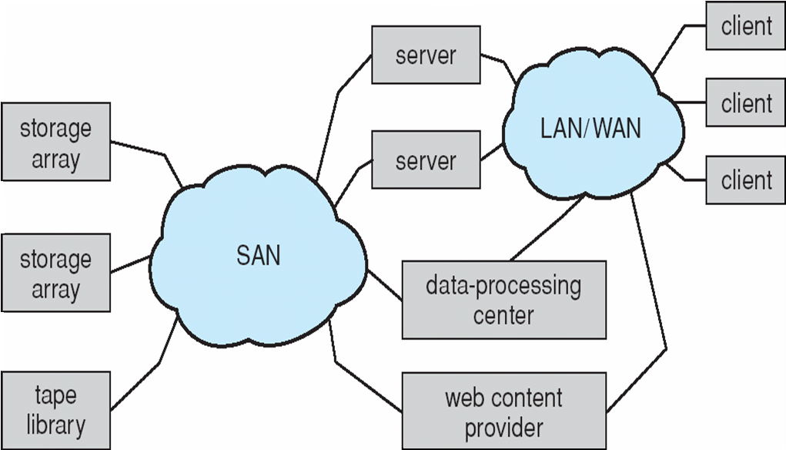
Storage Area Network
Common in large storage environments (and becoming more common)
Multiple hosts attached to multiple storage arrays - flexible
Lec 5
Operating Systems

Slide 22
Disk Performance
Response Time =
Lec 5
Operating Systems

Slide 23
Disk Performance
Response Time = Queue time + Service Time
  Latency factors
    Software paths
    Hardware controller
    Disk media
Queueing
  Latency goes up as disk utilization approaches 100%
What contributes to Service Time
Lec 5
Operating Systems

Slide 24
Service Time
Service Time = Controller + Seek + Rotation + Transfer
Controller: Process the request
Seek: Position the head/arm over the proper cylinder
Rotation: Wait for the requested sector to rotate under the head
Transfer: Transfer a block of bits from the drive to the system
Achieve highest bandwidth when transferring a large group of blocks sequentially from one track
Lec 5
Operating Systems

Slide 25
Queue Delay (Scheduling)
a, b, c, d, e, f, g, h, i, j, k
H
a
b
k
c
j
d
f
h
g
e
i
Lec 5
Operating Systems

Slide 26
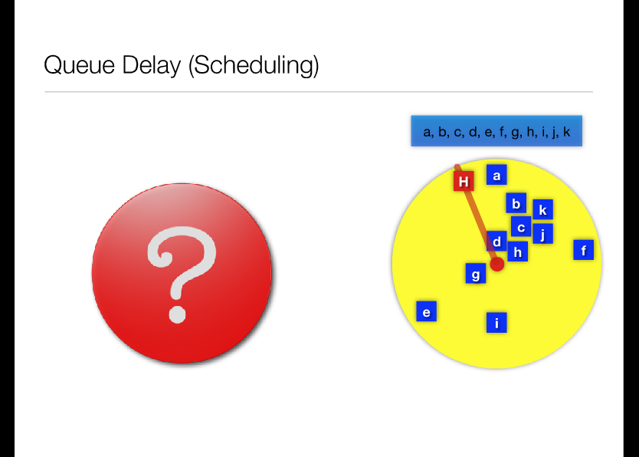
Lec 5
Operating Systems
Animation: Click here to advance; right click the content to replay

Slide 27
Disk Scheduling
The operating system is responsible for using hardware efficiently — for the disk drives, this means having a fast access time and disk bandwidth
Access time has two major components
  Seek time is the time for the disk are to move the heads to the cylinder containing the desired sector
  Rotational latency is the additional time waiting for the disk to rotate the desired sector to the disk head
Minimize seek time
Seek time ≈ seek distance
Disk bandwidth is the total number of bytes transferred, divided by the total time between the first request for service and the completion of the last transfer
Lec 5
Operating Systems

Slide 28
Disk Scheduling (Cont)
Several algorithms exist to schedule the servicing of disk I/O requests
We illustrate them with a request queue (0-199)
98, 183, 37, 122, 14, 124, 65, 67
Head pointer 53
Lec 5
Operating Systems

Slide 29

FCFS
Illustration shows total head movement of 640 cylinders
Lec 5
Operating Systems

Slide 30
SSTF
Selects the request with the minimum seek time from the current head position
SSTF scheduling is a form of SJF scheduling; may cause starvation of some requests
Illustration shows total head movement of 236 cylinders
Lec 5
Operating Systems

Slide 31

SSTF (Cont)
Lec 5
Operating Systems

Slide 32
SCAN
The disk arm starts at one end of the disk, and moves toward the other end, servicing requests until it gets to the other end of the disk, where the head movement is reversed and servicing continues.
SCAN algorithm Sometimes called the elevator algorithm
Illustration shows total head movement of 208 cylinders
Lec 5
Operating Systems

Slide 33

SCAN (Cont.)
Lec 5
Operating Systems

Slide 34
C-SCAN
Provides a more uniform wait time than SCAN
The head moves from one end of the disk to the other, servicing requests as it goes
  When it reaches the other end, however, it immediately returns to the beginning of the disk, without servicing any requests on the return trip
Treats the cylinders as a circular list that wraps around from the last cylinder to the first one
Lec 5
Operating Systems

Slide 35

C-SCAN (Cont)
Lec 5
Operating Systems

Slide 36
C-LOOK
Version of C-SCAN
Arm only goes as far as the last request in each direction, then reverses direction immediately, without first going all the way to the end of the disk
Lec 5
Operating Systems

Slide 37

C-LOOK (Cont)
Lec 5
Operating Systems

Slide 38
Selecting a Disk-Scheduling Algorithm
SSTF is common and has a natural appeal
SCAN and C-SCAN perform better for systems that place a heavy load on the disk
Performance depends on the number and types of requests
Requests for disk service can be influenced by the file-allocation method
The disk-scheduling algorithm should be written as a separate module of the operating system, allowing it to be replaced with a different algorithm if necessary
Either SSTF or LOOK is a reasonable choice for the default algorithm
Lec 5
Operating Systems

Slide 39
Linux Scheduling Algorithms
The Linus Elevator
Deadline Scheduling
Anticipatory Scheduling
Completely Fair Queuing (CFQ)
Noop Scheduler
http://linuxkernel2.atw.hu/ch13lev1sec5.html

Slide 40
Linux Scheduling Algorithms
Noop Scheduler
  Basic FCFS scheduler – all it does is keep the requests sorted by sector number
  Good for random-access block devices
Completely Fair Queuing (CFQ)
  Sort by sector number, but maintain process-level fairness by keeping a separate sorted queue for each process
  Service those queues round robin, with a quantum (ensures that each process will be served I/O every so often, i.e. for buffering purposes)
The Linus Elevator
  Sort by sector number, but check to see if some requests are getting starved (aging)
    If so, queue the request at the end, not in sorted order
http://linuxkernel2.atw.hu/ch13lev1sec5.html

Slide 41
Linux Scheduling Algorithms
Deadline Scheduling
  Reads block processes, as opposed to writes (typically), so mandate that reads be served within 500 ms, and writes within 5 seconds
    If something expires, start serving those requests in sorted order
    Otherwise, keep 3 queues: reads, writes, sorted order
Anticipatory Scheduling
  Same as above, but wait ~6ms for new requests to maintain the sort
  Risky (could lose that time if no new requests), but we hedge our bets by playing the numbers (due to locality)
http://linuxkernel2.atw.hu/ch13lev1sec5.html

Slide 42
Disk Management
Low-level formatting, or physical formatting — Dividing a disk into sectors that the disk controller can read and write
To use a disk to hold files, the operating system still needs to record its own data structures on the disk
  Partition the disk into one or more groups of cylinders
  Logical formatting or “making a file system”
  To increase efficiency most file systems group blocks into clusters
    Disk I/O done in blocks
    File I/O done in clusters
Boot block initializes system
  The bootstrap is stored in ROM
  Bootstrap loader program
Methods such as sector sparing used to handle bad blocks
Lec 5
Operating Systems

Slide 43

Booting from a Disk in Windows 2000
Lec 5
Operating Systems

Slide 44
Swap-Space Management
Swap-space — Virtual memory uses disk space as an extension of main memory
Swap-space can be carved out of the normal file system, or, more commonly, it can be in a separate disk partition
Swap-space management
  4.3BSD allocates swap space when process starts; holds text segment (the program) and data segment
  Kernel uses swap maps to track swap-space use
  Solaris 2 allocates swap space only when a page is forced out of physical memory, not when the virtual memory page is first created
Lec 5
Operating Systems

Slide 45
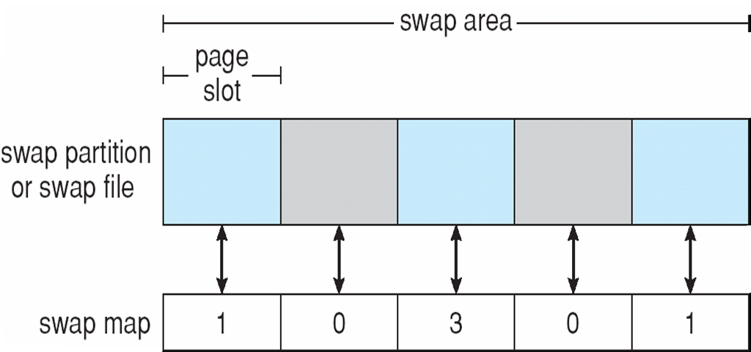
Data Structures for Swapping on Linux Systems
Lec 5
Operating Systems

Slide 46
RAID Structure
RAID – multiple disk drives provides reliability via redundancy
Increases the mean time to failure
Frequently combined with NVRAM to improve write performance
RAID is arranged into six different levels
Lec 5
Operating Systems

Slide 47
RAID (Cont)
Several improvements in disk-use techniques involve the use of multiple disks working cooperatively
Disk striping uses a group of disks as one storage unit
RAID schemes improve performance and improve the reliability of the storage system by storing redundant data
  Mirroring or shadowing (RAID 1) keeps duplicate of each disk
  Striped mirrors (RAID 1+0) or mirrored stripes (RAID 0+1) provides high performance and high reliability
  Block interleaved parity (RAID 4, 5, 6) uses much less redundancy
RAID within a storage array can still fail if the array fails, so automatic replication of the data between arrays is common
Frequently, a small number of hot-spare disks are left unallocated, automatically replacing a failed disk and having data rebuilt onto them
Lec 5
Operating Systems

Slide 48
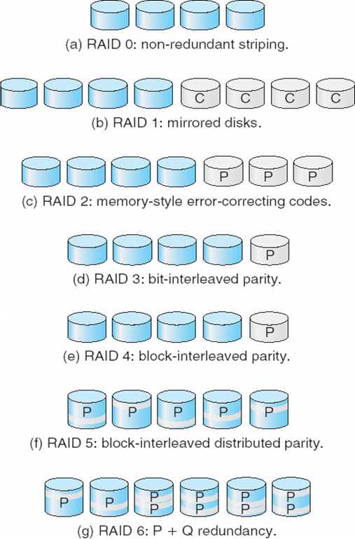
RAID Levels
Lec 5
Operating Systems

Slide 49
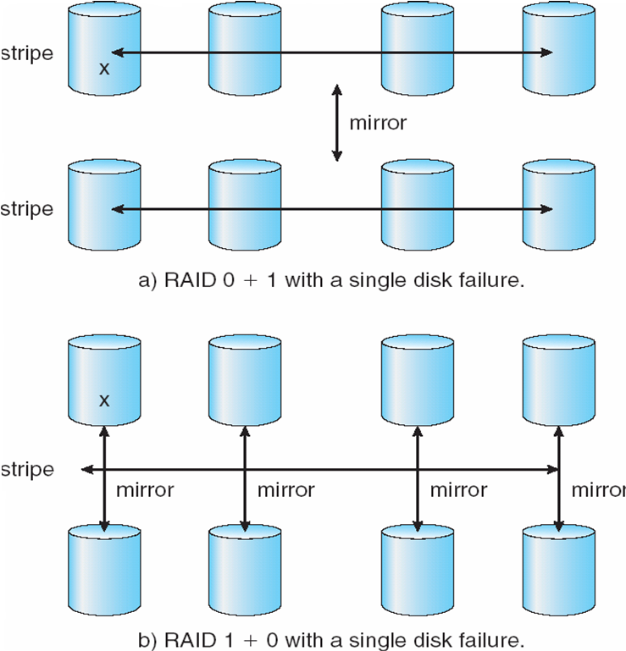
RAID (0 + 1) and (1 + 0)
Lec 5
Operating Systems

Slide 50
Extensions
RAID alone does not prevent or detect data corruption or other errors, just disk failures
Solaris ZFS adds checksums of all data and metadata
Checksums kept with pointer to object, to detect if object is the right one and whether it changed
Can detect and correct data and metadata corruption
ZFS also removes volumes, partititions
  Disks allocated in pools
  Filesystems with a pool share that pool, use and release space like “malloc” and “free” memory allocate / release calls
Lec 5
Operating Systems

Slide 51
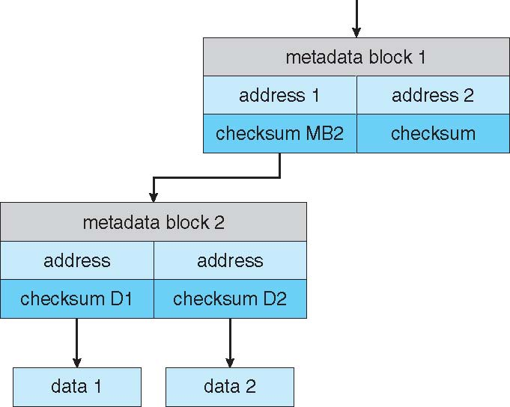
ZFS Checksums All Metadata and Data
Lec 5
Operating Systems

Slide 52
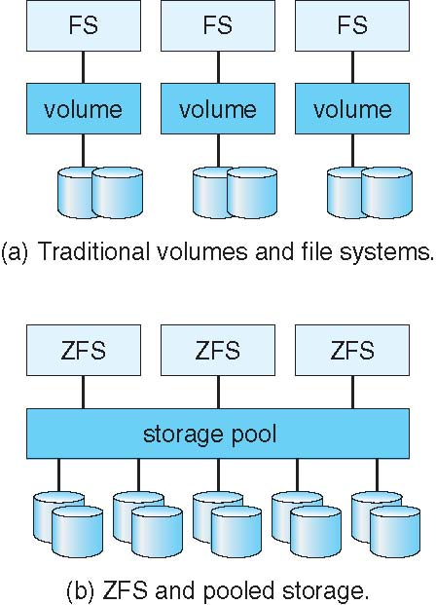
Traditional and Pooled Storage
Lec 5
Operating Systems

Slide 53
Stable-Storage Implementation
Write-ahead log scheme requires stable storage
To implement stable storage:
  Replicate information on more than one nonvolatile storage media with independent failure modes
  Update information in a controlled manner to ensure that we can recover the stable data after any failure during data transfer or recovery
Lec 5
Operating Systems

Slide 54
Tertiary Storage Devices
Low cost is the defining characteristic of tertiary storage
Generally, tertiary storage is built using removable media
Common examples of removable media are floppy disks and CD-ROMs; other types are available
Lec 5
Operating Systems

Slide 55
Removable Disks
Floppy disk — thin flexible disk coated with magnetic material, enclosed in a protective plastic case
  Most floppies hold about 1 MB; similar technology is used for removable disks that hold more than 1 GB
  Removable magnetic disks can be nearly as fast as hard disks, but they are at a greater risk of damage from exposure
Lec 5
Operating Systems

Slide 56
Removable Disks (Cont.)
A magneto-optic disk records data on a rigid platter coated with magnetic material
  Laser heat is used to amplify a large, weak magnetic field to record a bit
  Laser light is also used to read data (Kerr effect)
  The magneto-optic head flies much farther from the disk surface than a magnetic disk head, and the magnetic material is covered with a protective layer of plastic or glass; resistant to head crashes
Optical disks do not use magnetism; they employ special materials that are altered by laser light
Lec 5
Operating Systems

Slide 57
WORM Disks
The data on read-write disks can be modified over and over
WORM (“Write Once, Read Many Times”) disks can be written only once
Thin aluminum film sandwiched between two glass or plastic platters
To write a bit, the drive uses a laser light to burn a small hole through the aluminum; information can be destroyed by not altered
Very durable and reliable
Read-only disks, such ad CD-ROM and DVD, com from the factory with the data pre-recorded
Lec 5
Operating Systems

Slide 58
Tapes
Compared to a disk, a tape is less expensive and holds more data, but random access is much slower
Tape is an economical medium for purposes that do not require fast random access, e.g., backup copies of disk data, holding huge volumes of data
Large tape installations typically use robotic tape changers that move tapes between tape drives and storage slots in a tape library
  stacker – library that holds a few tapes
  silo – library that holds thousands of tapes
A disk-resident file can be archived to tape for low cost storage; the computer can stage it back into disk storage for active use
Lec 5
Operating Systems

Slide 59
Operating System Support
Major OS jobs are to manage physical devices and to present a virtual machine abstraction to applications
For hard disks, the OS provides two abstraction:
  Raw device – an array of data blocks
  File system – the OS queues and schedules the interleaved requests from several applications
Lec 5
Operating Systems

Slide 60
Application Interface
Most OSs handle removable disks almost exactly like fixed disks — a new cartridge is formatted and an empty file system is generated on the disk
Tapes are presented as a raw storage medium, i.e., and application does not not open a file on the tape, it opens the whole tape drive as a raw device
Usually the tape drive is reserved for the exclusive use of that application
Since the OS does not provide file system services, the application must decide how to use the array of blocks
Since every application makes up its own rules for how to organize a tape, a tape full of data can generally only be used by the program that created it
Lec 5
Operating Systems

Slide 61
Tape Drives
The basic operations for a tape drive differ from those of a disk drive
locate() positions the tape to a specific logical block, not an entire track (corresponds to seek())
The read position() operation returns the logical block number where the tape head is
The space() operation enables relative motion
Tape drives are “append-only” devices; updating a block in the middle of the tape also effectively erases everything beyond that block
An EOT mark is placed after a block that is written
Lec 5
Operating Systems

Slide 62
File Naming
The issue of naming files on removable media is especially difficult when we want to write data on a removable cartridge on one computer, and then use the cartridge in another computer
Contemporary OSs generally leave the name space problem unsolved for removable media, and depend on applications and users to figure out how to access and interpret the data
Some kinds of removable media (e.g., CDs) are so well standardized that all computers use them the same way
Lec 5
Operating Systems

Slide 63
Hierarchical Storage Management (HSM)
A hierarchical storage system extends the storage hierarchy beyond primary memory and secondary storage to incorporate tertiary storage — usually implemented as a jukebox of tapes or removable disks
Usually incorporate tertiary storage by extending the file system
  Small and frequently used files remain on disk
  Large, old, inactive files are archived to the jukebox
HSM is usually found in supercomputing centers and other large installations that have enormous volumes of data
Lec 5
Operating Systems

Slide 64
Speed
Two aspects of speed in tertiary storage are bandwidth and latency
Bandwidth is measured in bytes per second
  Sustained bandwidth – average data rate during a large transfer; # of bytes/transfer time
  Data rate when the data stream is actually flowing
  Effective bandwidth – average over the entire I/O time, including seek() or locate(), and cartridge switching
  Drive’s overall data rate
Lec 5
Operating Systems

Slide 65
Speed (Cont)
Access latency – amount of time needed to locate data
  Access time for a disk – move the arm to the selected cylinder and wait for the rotational latency; < 35 milliseconds
  Access on tape requires winding the tape reels until the selected block reaches the tape head; tens or hundreds of seconds
  Generally say that random access within a tape cartridge is about a thousand times slower than random access on disk
The low cost of tertiary storage is a result of having many cheap cartridges share a few expensive drives
A removable library is best devoted to the storage of infrequently used data, because the library can only satisfy a relatively small number of I/O requests per hour
Lec 5
Operating Systems

Slide 66
Reliability
A fixed disk drive is likely to be more reliable than a removable disk or tape drive
An optical cartridge is likely to be more reliable than a magnetic disk or tape
A head crash in a fixed hard disk generally destroys the data, whereas the failure of a tape drive or optical disk drive often leaves the data cartridge unharmed
Lec 5
Operating Systems

Slide 67
Cost
Main memory is much more expensive than disk storage
The cost per megabyte of hard disk storage is competitive with magnetic tape if only one tape is used per drive
The cheapest tape drives and the cheapest disk drives have had about the same storage capacity over the years
Tertiary storage gives a cost savings only when the number of cartridges is considerably larger than the number of drives
Lec 5
Operating Systems

Slide 68
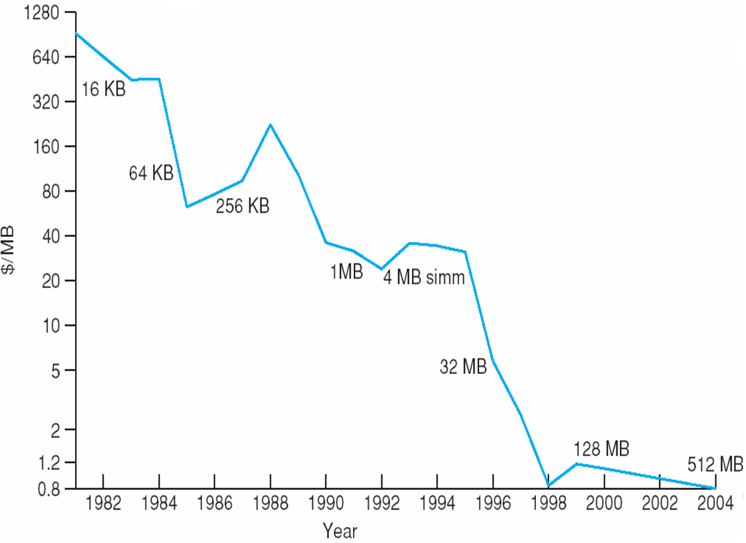
Price per Megabyte of DRAM, From 1981 to 2004
Lec 5
Operating Systems

Slide 69
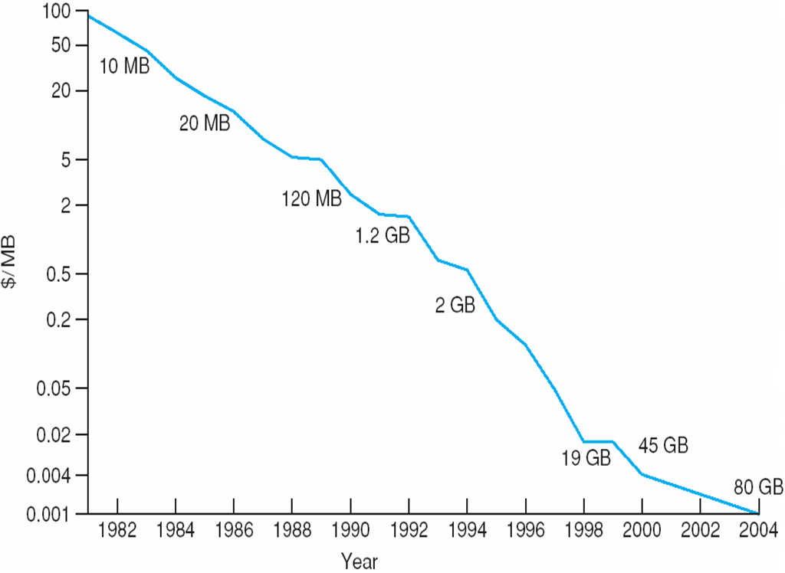
Price per Megabyte of Magnetic Hard Disk, From 1981 to 2004
Lec 5
Operating Systems

Slide 70
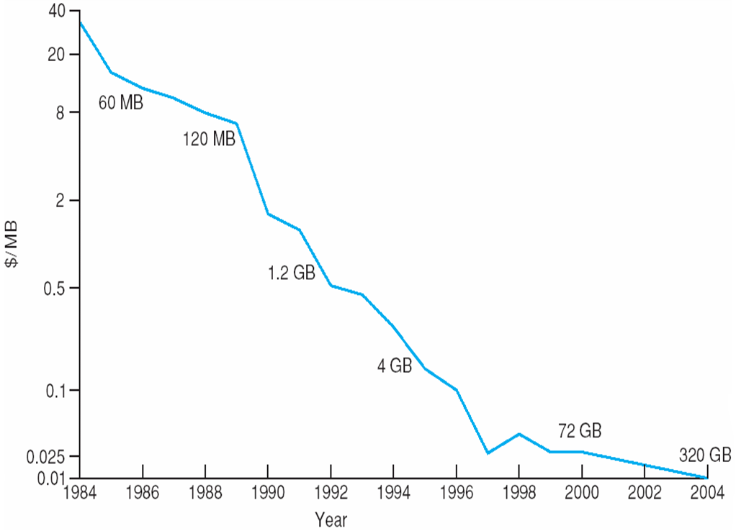
Price per Megabyte of a Tape Drive, From 1984-2000
Lec 5
Operating Systems

Slide 71
Chapter 13: I/O Systems
I/O Hardware
Application I/O Interface
Kernel I/O Subsystem
Transforming I/O Requests to Hardware Operations
STREAMS
Performance
Lec 5
Operating Systems

Slide 72
Objectives
Explore the structure of an operating system’s I/O subsystem
Discuss the principles of I/O hardware and its complexity
Provide details of the performance aspects of I/O hardware and software
Lec 5
Operating Systems

Slide 73
I/O Hardware
Incredible variety of I/O devices
Common concepts
  Port
  Bus (daisy chain or shared direct access)
  Controller (host adapter)
I/O instructions control devices
Devices have addresses, used by
  Direct I/O instructions
  Memory-mapped I/O
Lec 5
Operating Systems

Slide 74
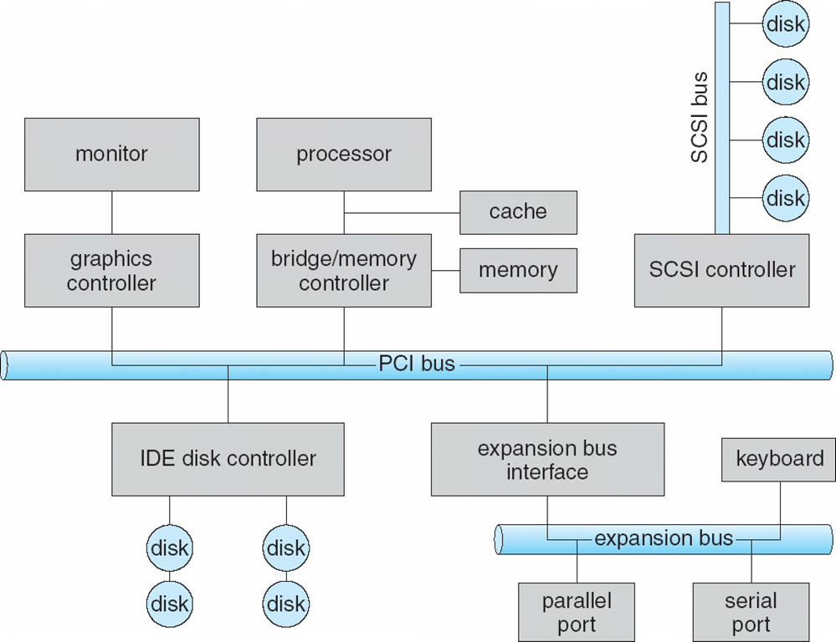
A Typical PC Bus Structure
Lec 5
Operating Systems

Slide 75
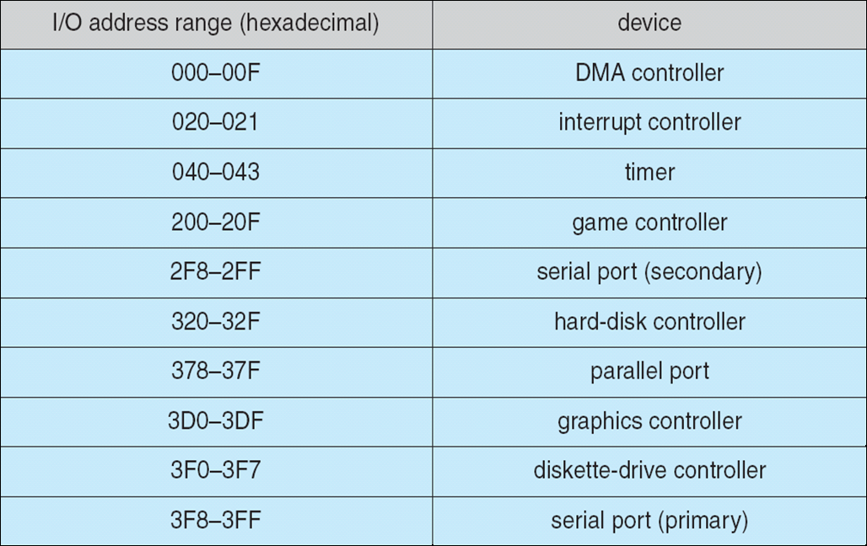
Device I/O Port Locations on PCs (partial)
Lec 5
Operating Systems

Slide 76
Polling
Determines state of device
  command-ready
  busy
  Error
Busy-wait cycle to wait for I/O from device
Lec 5
Operating Systems

Slide 77
Interrupts
CPU Interrupt-request line triggered by I/O device
Interrupt handler receives interrupts
Maskable to ignore or delay some interrupts
Interrupt vector to dispatch interrupt to correct handler
  Based on priority
  Some nonmaskable
Interrupt mechanism also used for exceptions
Lec 5
Operating Systems

Slide 78
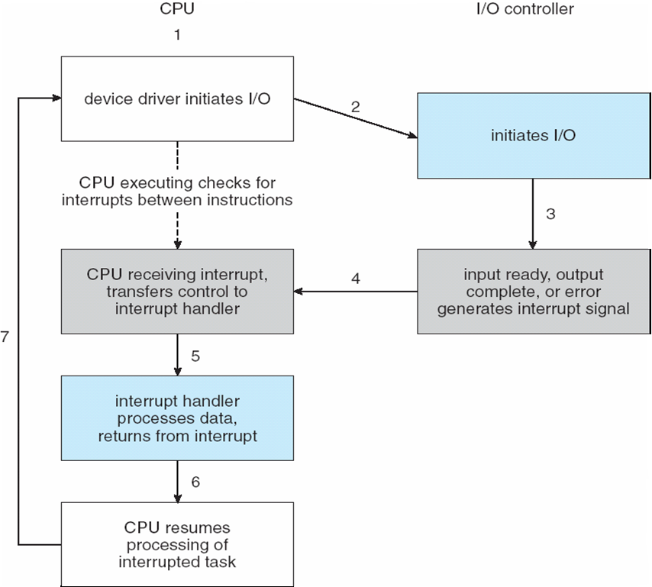
Interrupt-Driven I/O Cycle
Lec 5
Operating Systems

Slide 79
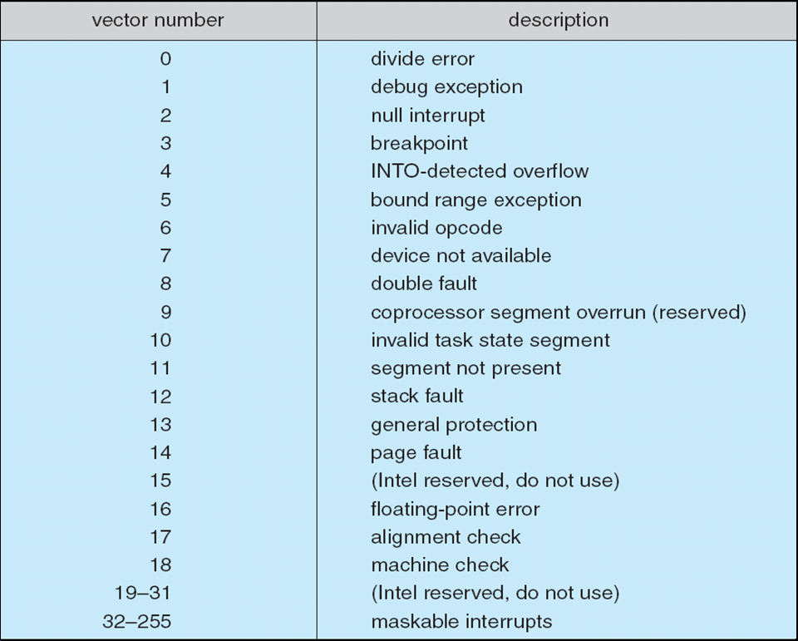
Intel Pentium Processor Event-Vector Table
Lec 5
Operating Systems

Slide 80
Direct Memory Access
Used to avoid programmed I/O for large data movement
Requires DMA controller
Bypasses CPU to transfer data directly between I/O device and memory
Lec 5
Operating Systems

Slide 81
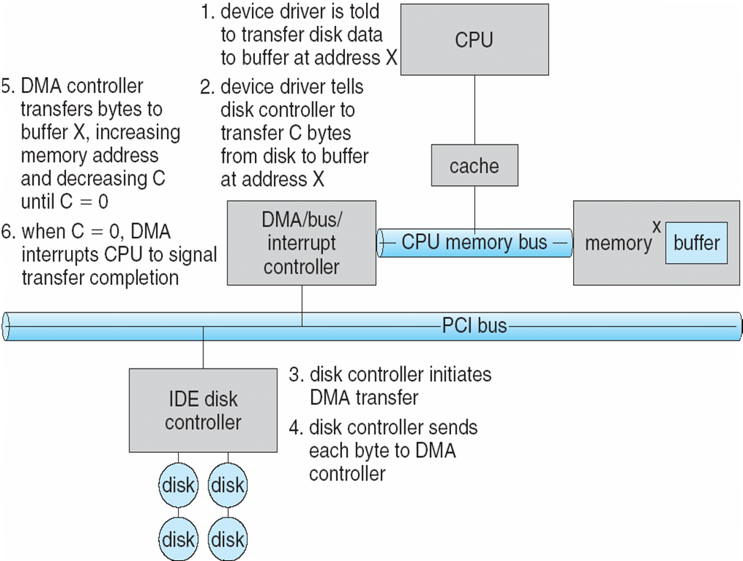
Six Step Process to Perform DMA Transfer
Lec 5
Operating Systems

Slide 82
Application I/O Interface
I/O system calls encapsulate device behaviors in generic classes
Device-driver layer hides differences among I/O controllers from kernel
Devices vary in many dimensions
  Character-stream or block
  Sequential or random-access
  Sharable or dedicated
  Speed of operation
  read-write, read only, or write only
Lec 5
Operating Systems

Slide 83
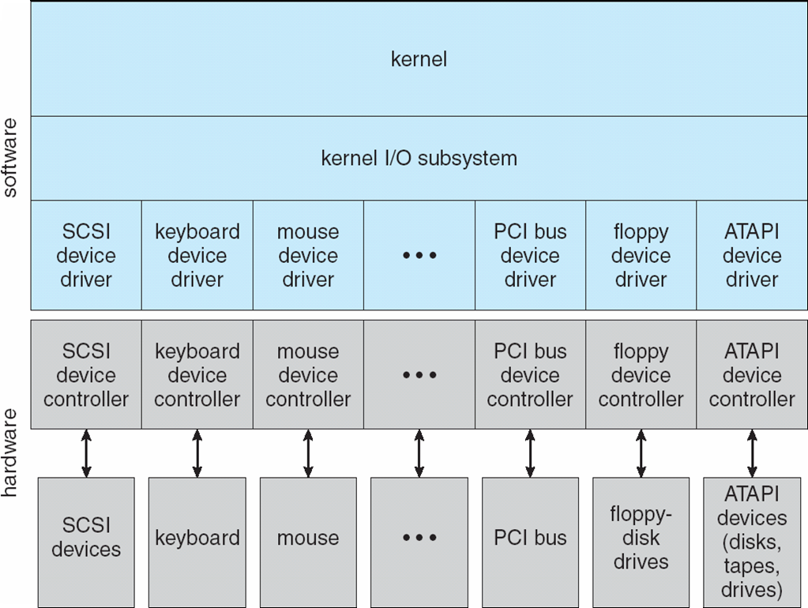
A Kernel I/O Structure
Lec 5
Operating Systems

Slide 84
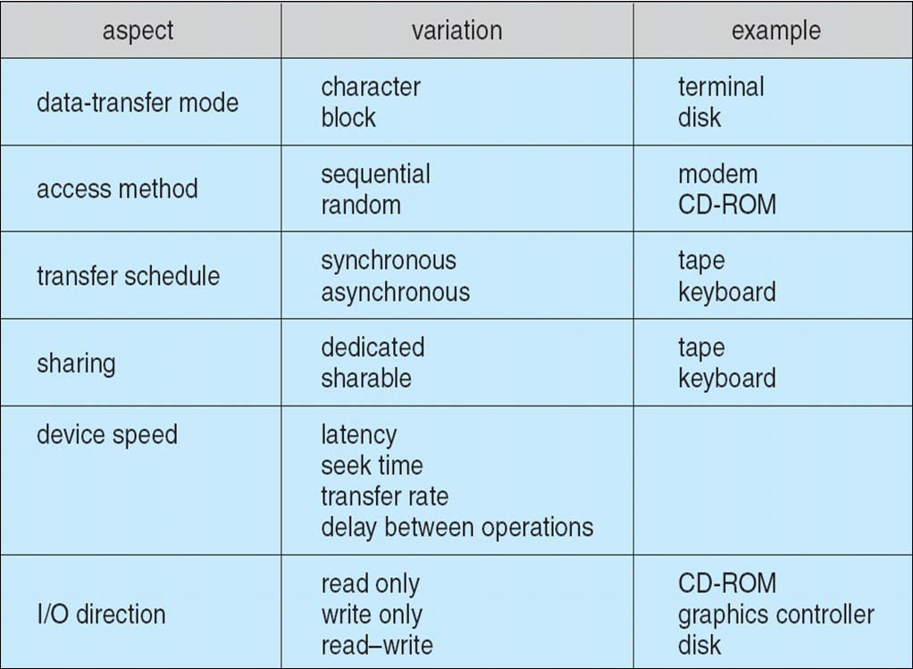
Characteristics of I/O Devices
Lec 5
Operating Systems

Slide 85
Block and Character Devices
Block devices include disk drives
  Commands include read, write, seek
  Raw I/O or file-system access
  Memory-mapped file access possible
Character devices include keyboards, mice, serial ports
  Commands include get(), put()
  Libraries layered on top allow line editing
Lec 5
Operating Systems

Slide 86
Network Devices
Varying enough from block and character to have own interface
Unix and Windows NT/9x/2000 include socket interface
  Separates network protocol from network operation
  Includes select() functionality
Approaches vary widely (pipes, FIFOs, streams, queues, mailboxes)
Lec 5
Operating Systems

Slide 87
Clocks and Timers
Provide current time, elapsed time, timer
Programmable interval timer used for timings, periodic interrupts
ioctl() (on UNIX) covers odd aspects of I/O such as clocks and timers
Lec 5
Operating Systems

Slide 88
Blocking and Nonblocking I/O
Blocking - process suspended until I/O completed
  Easy to use and understand
  Insufficient for some needs
Nonblocking - I/O call returns as much as available
  User interface, data copy (buffered I/O)
  Implemented via multi-threading
  Returns quickly with count of bytes read or written
Asynchronous - process runs while I/O executes
  Difficult to use
  I/O subsystem signals process when I/O completed
Lec 5
Operating Systems

Slide 89
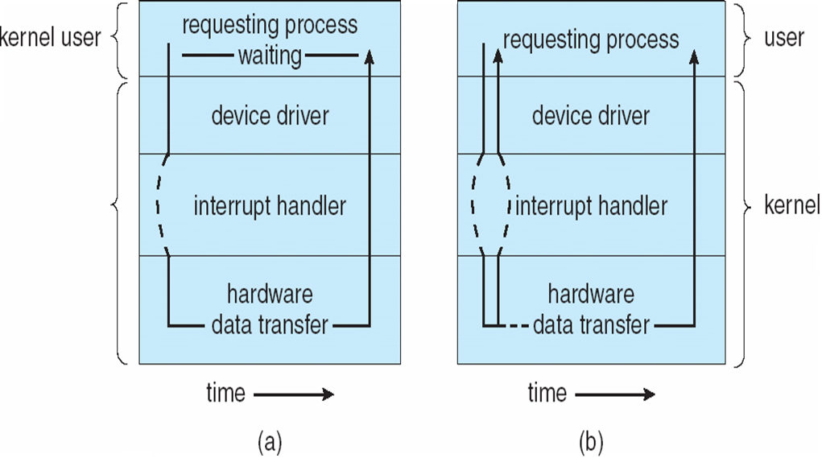
Two I/O Methods
Synchronous
Asynchronous
Lec 5
Operating Systems

Slide 90
Kernel I/O Subsystem
Scheduling
  Some I/O request ordering via per-device queue
  Some OSs try fairness
Buffering - store data in memory while transferring between devices
  To cope with device speed mismatch
  To cope with device transfer size mismatch
  To maintain “copy semantics”
Lec 5
Operating Systems

Slide 91
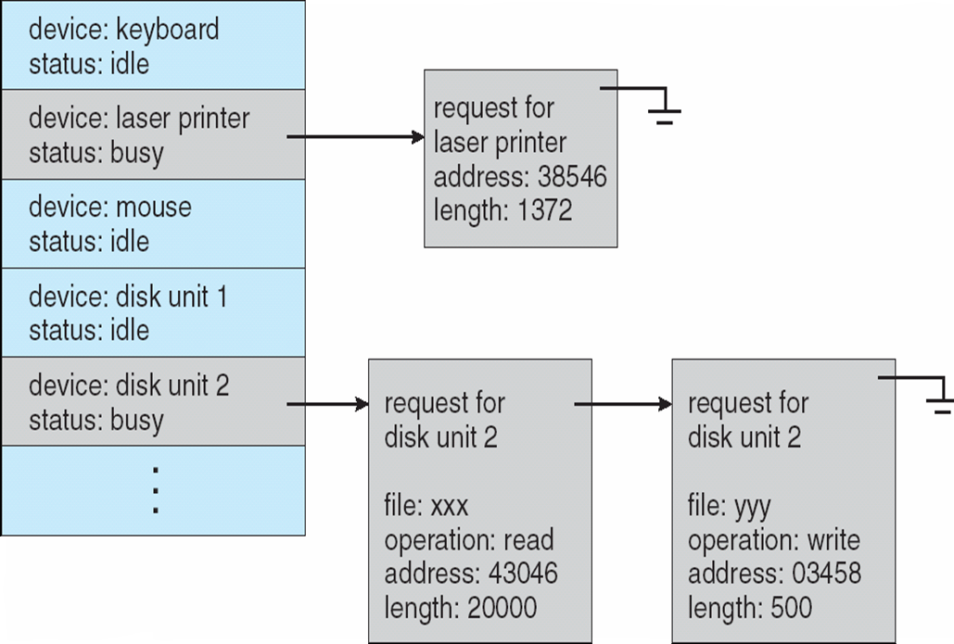
Device-status Table
Lec 5
Operating Systems

Slide 92
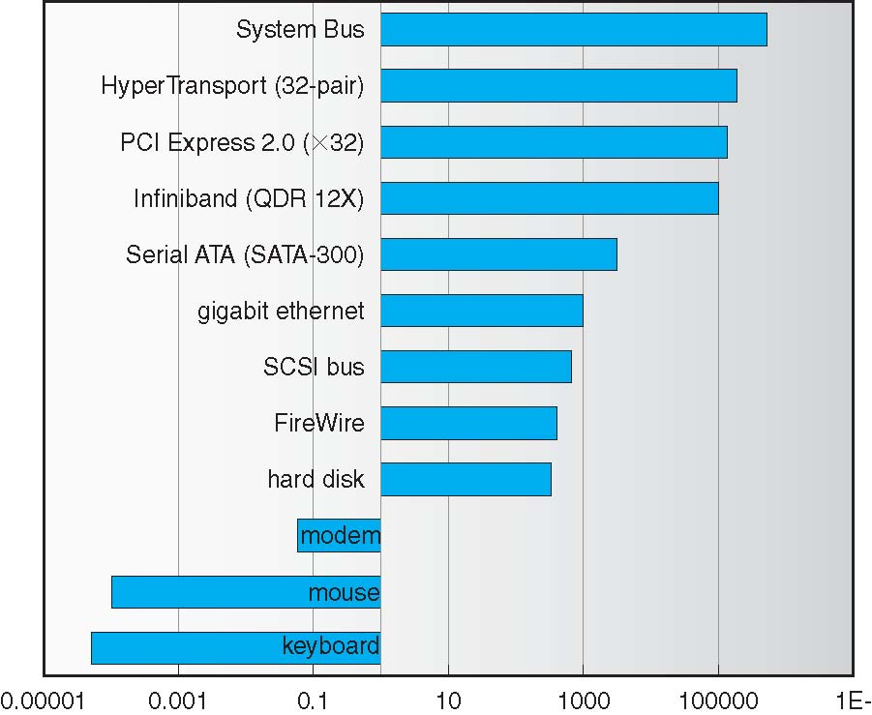
Sun Enterprise 6000 Device-Transfer Rates
Lec 5
Operating Systems

Slide 93
Kernel I/O Subsystem
Caching - fast memory holding copy of data
  Always just a copy
  Key to performance
Spooling - hold output for a device
  If device can serve only one request at a time
  i.e., Printing
Device reservation - provides exclusive access to a device
  System calls for allocation and deallocation
  Watch out for deadlock
Lec 5
Operating Systems

Slide 94
Error Handling
OS can recover from disk read, device unavailable, transient write failures
Most return an error number or code when I/O request fails
System error logs hold problem reports
Lec 5
Operating Systems

Slide 95
I/O Protection
User process may accidentally or purposefully attempt to disrupt normal operation via illegal I/O instructions
  All I/O instructions defined to be privileged
  I/O must be performed via system calls
    Memory-mapped and I/O port memory locations must be protected too
Lec 5
Operating Systems

Slide 96
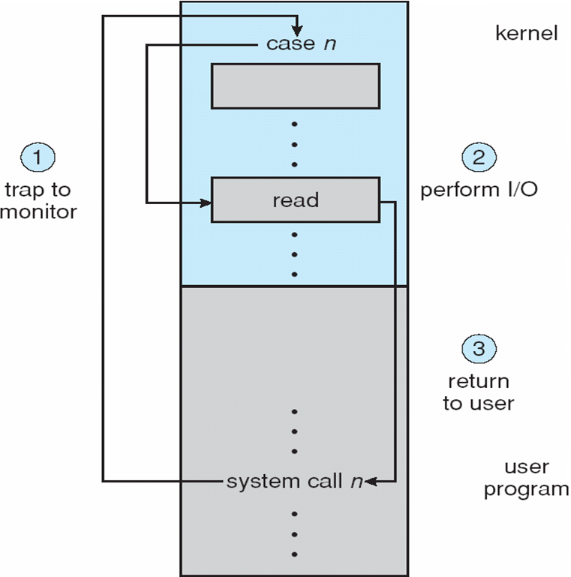
Use of a System Call to Perform I/O
Lec 5
Operating Systems

Slide 97
Kernel Data Structures
Kernel keeps state info for I/O components, including open file tables, network connections, character device state
Many, many complex data structures to track buffers, memory allocation, “dirty” blocks
Some use object-oriented methods and message passing to implement I/O
Lec 5
Operating Systems

Slide 98
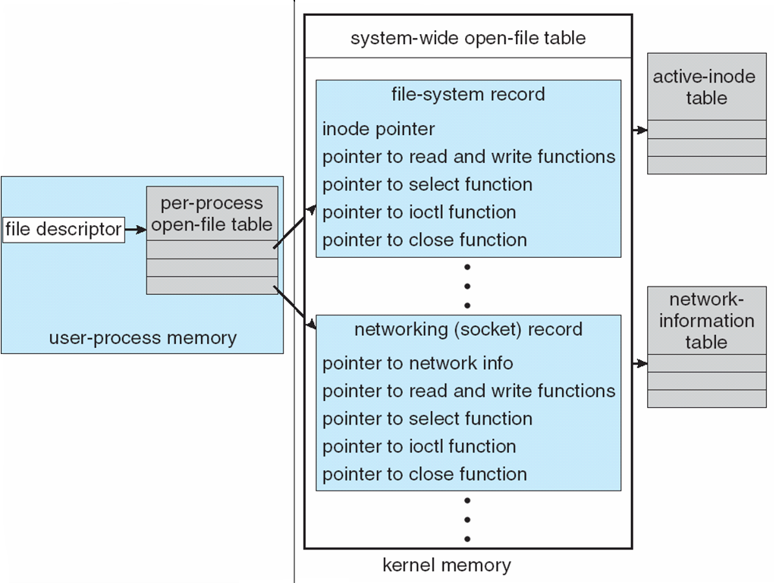
UNIX I/O Kernel Structure
Lec 5
Operating Systems

Slide 99
I/O Requests to Hardware Operations
Consider reading a file from disk for a process:
  Determine device holding file
  Translate name to device representation
  Physically read data from disk into buffer
  Make data available to requesting process
  Return control to process
Lec 5
Operating Systems

Slide 100
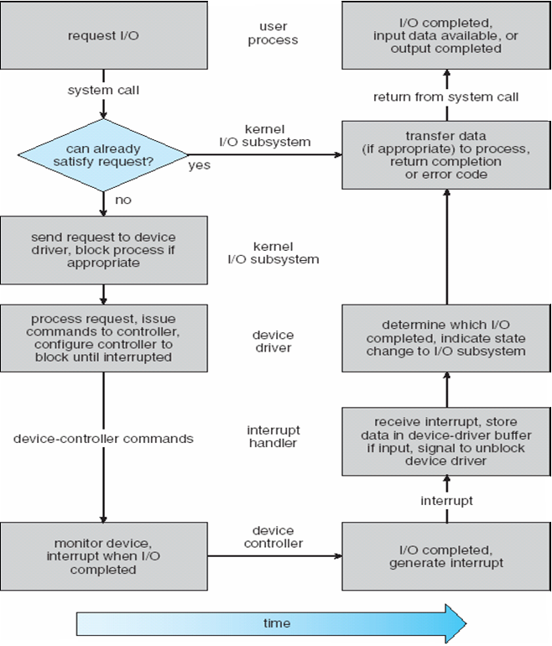
Life Cycle of An I/O Request
Lec 5
Operating Systems

Slide 101
STREAMS
STREAM – a full-duplex communication channel between a user-level process and a device in Unix System V and beyond
A STREAM consists of:
- STREAM head interfaces with the user process
- driver end interfaces with the device
- zero or more STREAM modules between them.
Each module contains a read queue and a write queue
Message passing is used to communicate between queues
Lec 5
Operating Systems

Slide 102
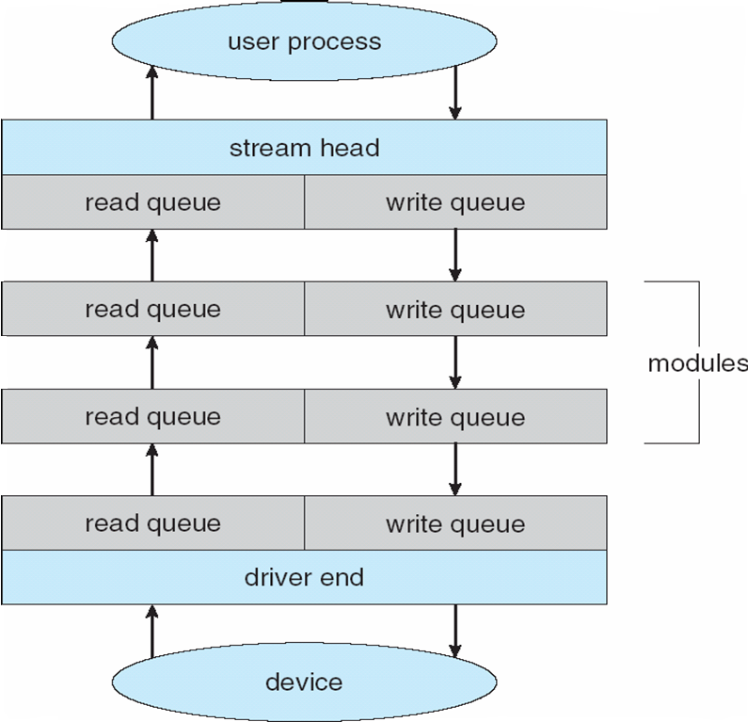
The STREAMS Structure
Lec 5
Operating Systems

Slide 103
Performance
I/O a major factor in system performance:
  Demands CPU to execute device driver, kernel I/O code
  Context switches due to interrupts
  Data copying
  Network traffic especially stressful
Lec 5
Operating Systems

Slide 104
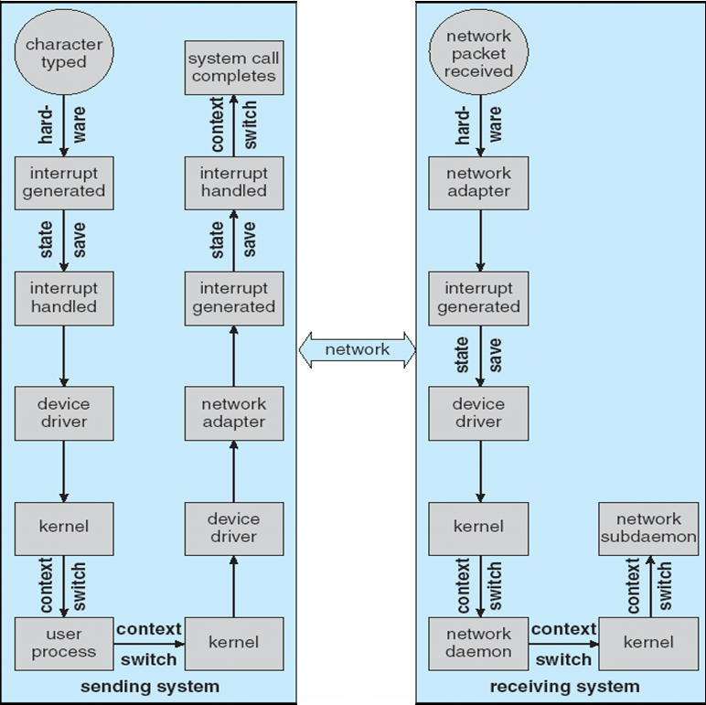
Intercomputer Communications
Lec 5
Operating Systems

Slide 105
Improving Performance
Reduce number of context switches
Reduce data copying
Reduce interrupts by using large transfers, smart controllers, polling
Use DMA
Balance CPU, memory, bus, and I/O performance for highest throughput
Lec 5
Operating Systems

Slide 106
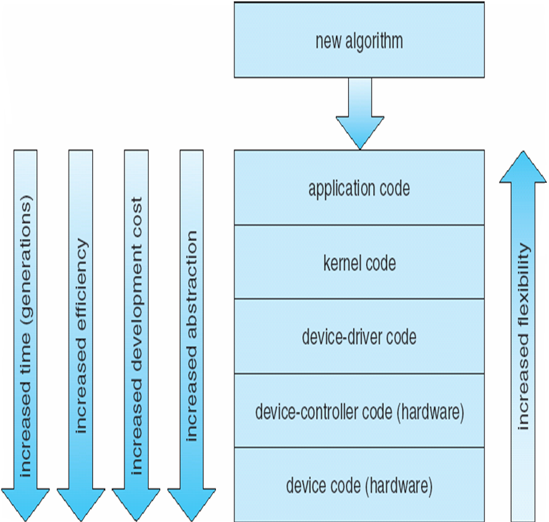
Device-Functionality Progression
Lec 5
Operating Systems

Slide 107
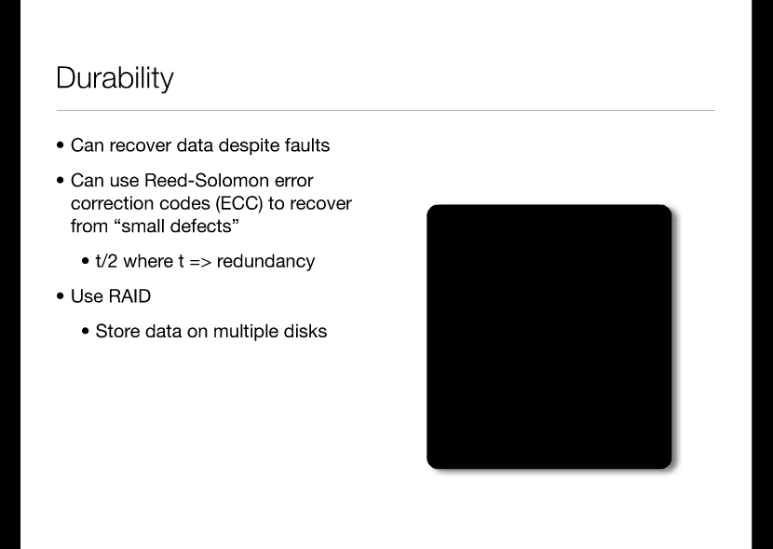
Lec 5
Operating Systems
Animation: Click here to advance; right click the content to replay

Slide 108
RAID: Redundant Arrays of Inexpensive DIsks
RAID 1: Full mirroring/Shadowing
  Most Expensive
  Bandwidth sacrifice: 1 write = 2
  To recover simply swap out a disk, can be hot swappable
RAID 5+: High I/O Rate Parity
  Stripped across multiple disks
Disk 1
Disk 2
Disk 3
Disk 4
Disk 5
D0
D1
D2
D3
P0
D4
D5
D6
P1
D7
D8
D9
P2
D10
D11
D12
P3
D13
D14
D15
P4
D16
D17
D18
D19
D20
D21
D22
D23
P5
P0
=
D0
⊗
D1
⊗
D2
⊗
D3
Lec 5
Operating Systems

